Slide 2
Agenda
What is MPS
Secure Sharing Flow
Implementation Process
Conversation Topics
Q&A

Slide 3
What is MPS
MPS (Mail Protection Service) enables secure collaboration with minimal or no user intervention. It integrates with Mail and DLP servers to secure emails and contained attachments according to predefined organizational policies.

Slide 4
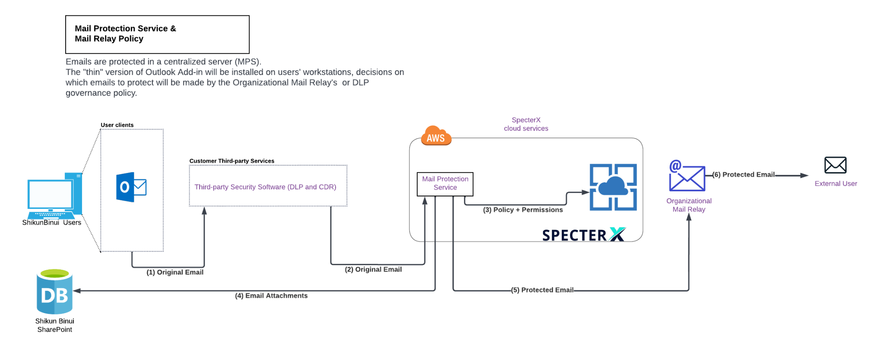
Secure Sharing Flow
Storage

Slide 5
Implementation Process
Prerequisites
Implementation
User Onboarding
Introduction Session
Architecture
Gather information
Timeframe
DLP and Mail flow
Transport rules
etc
Check email flow rules
Try-out the Add-in
Enforce email rules
Deploy new Add-in for organization users

Slide 6
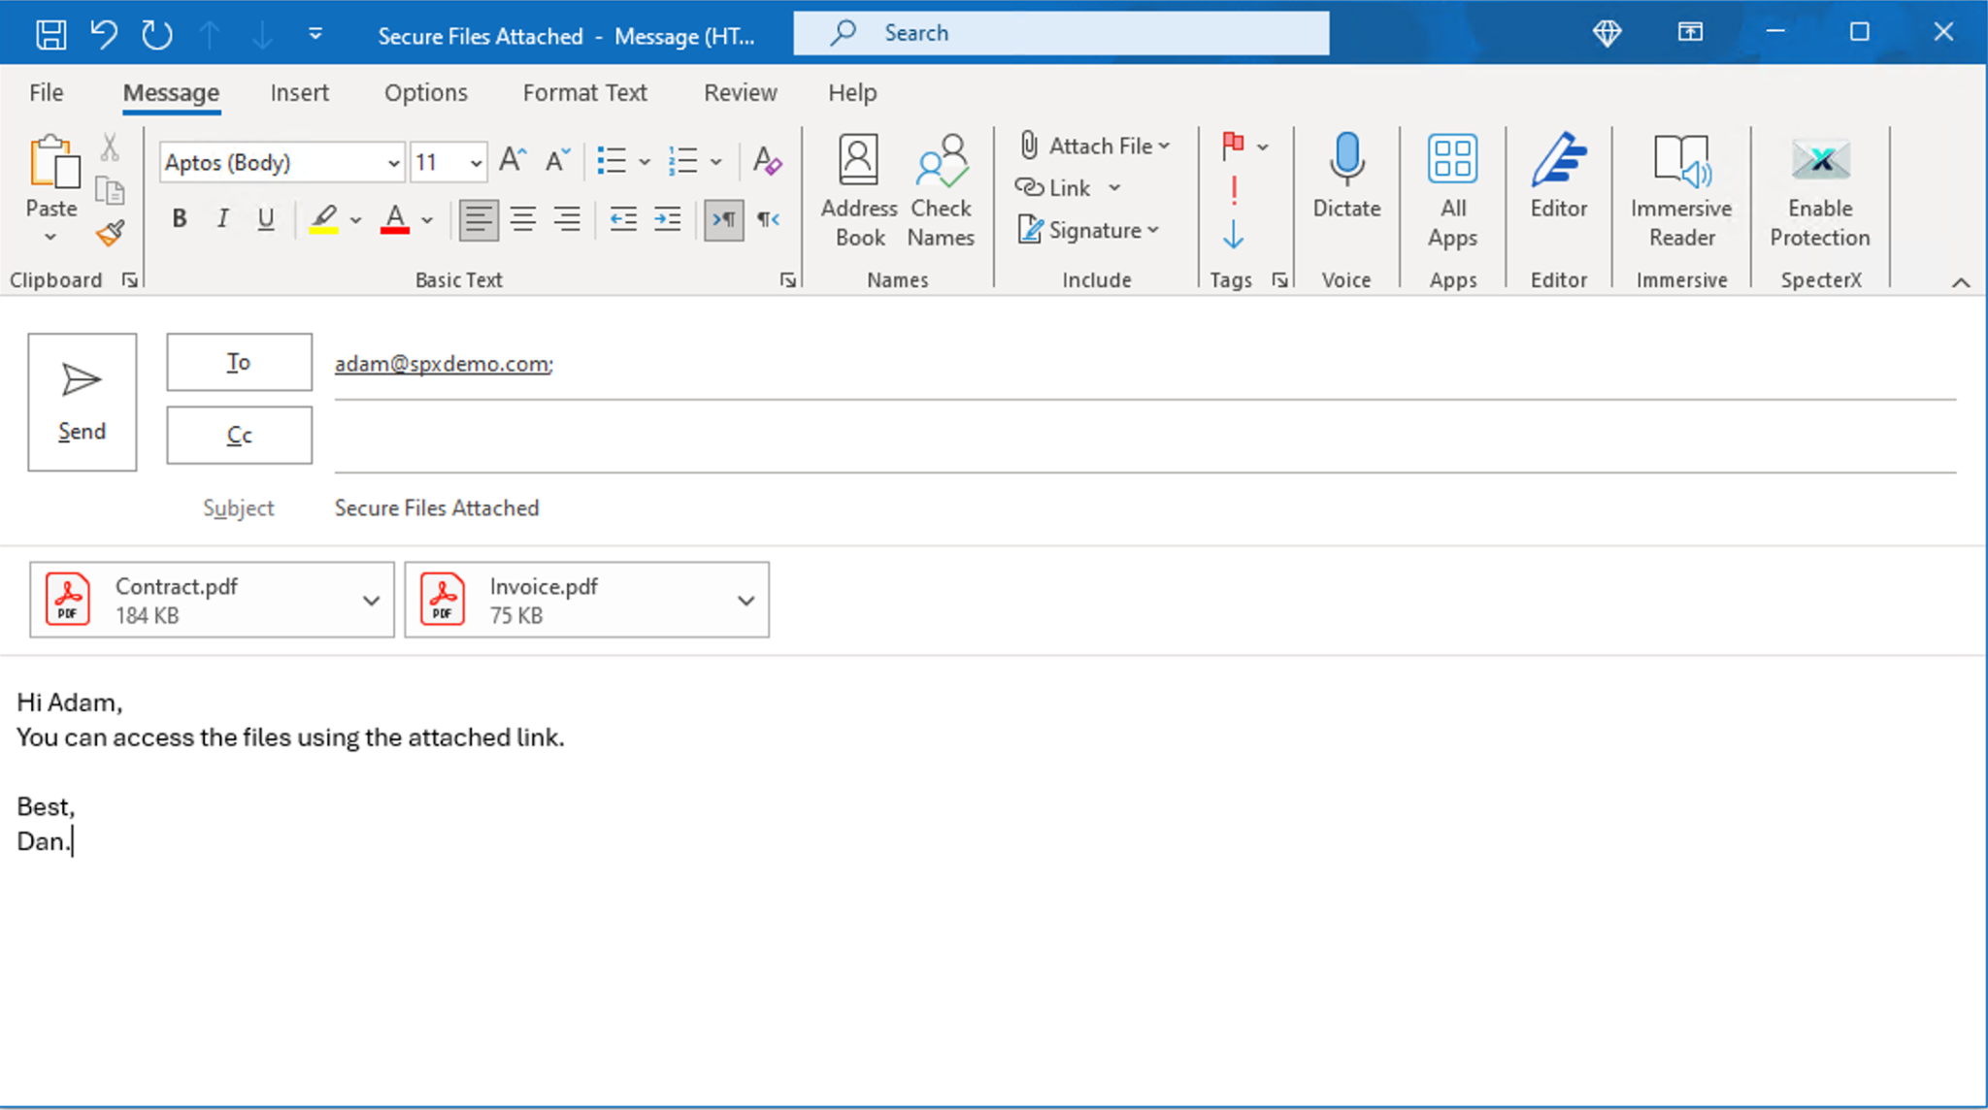
Sender Experience
Seamless user experience for organization users.
Emails will be protected according to the organizational Mail Relay's governance policy and SpecterX predefined access policy.

Slide 7
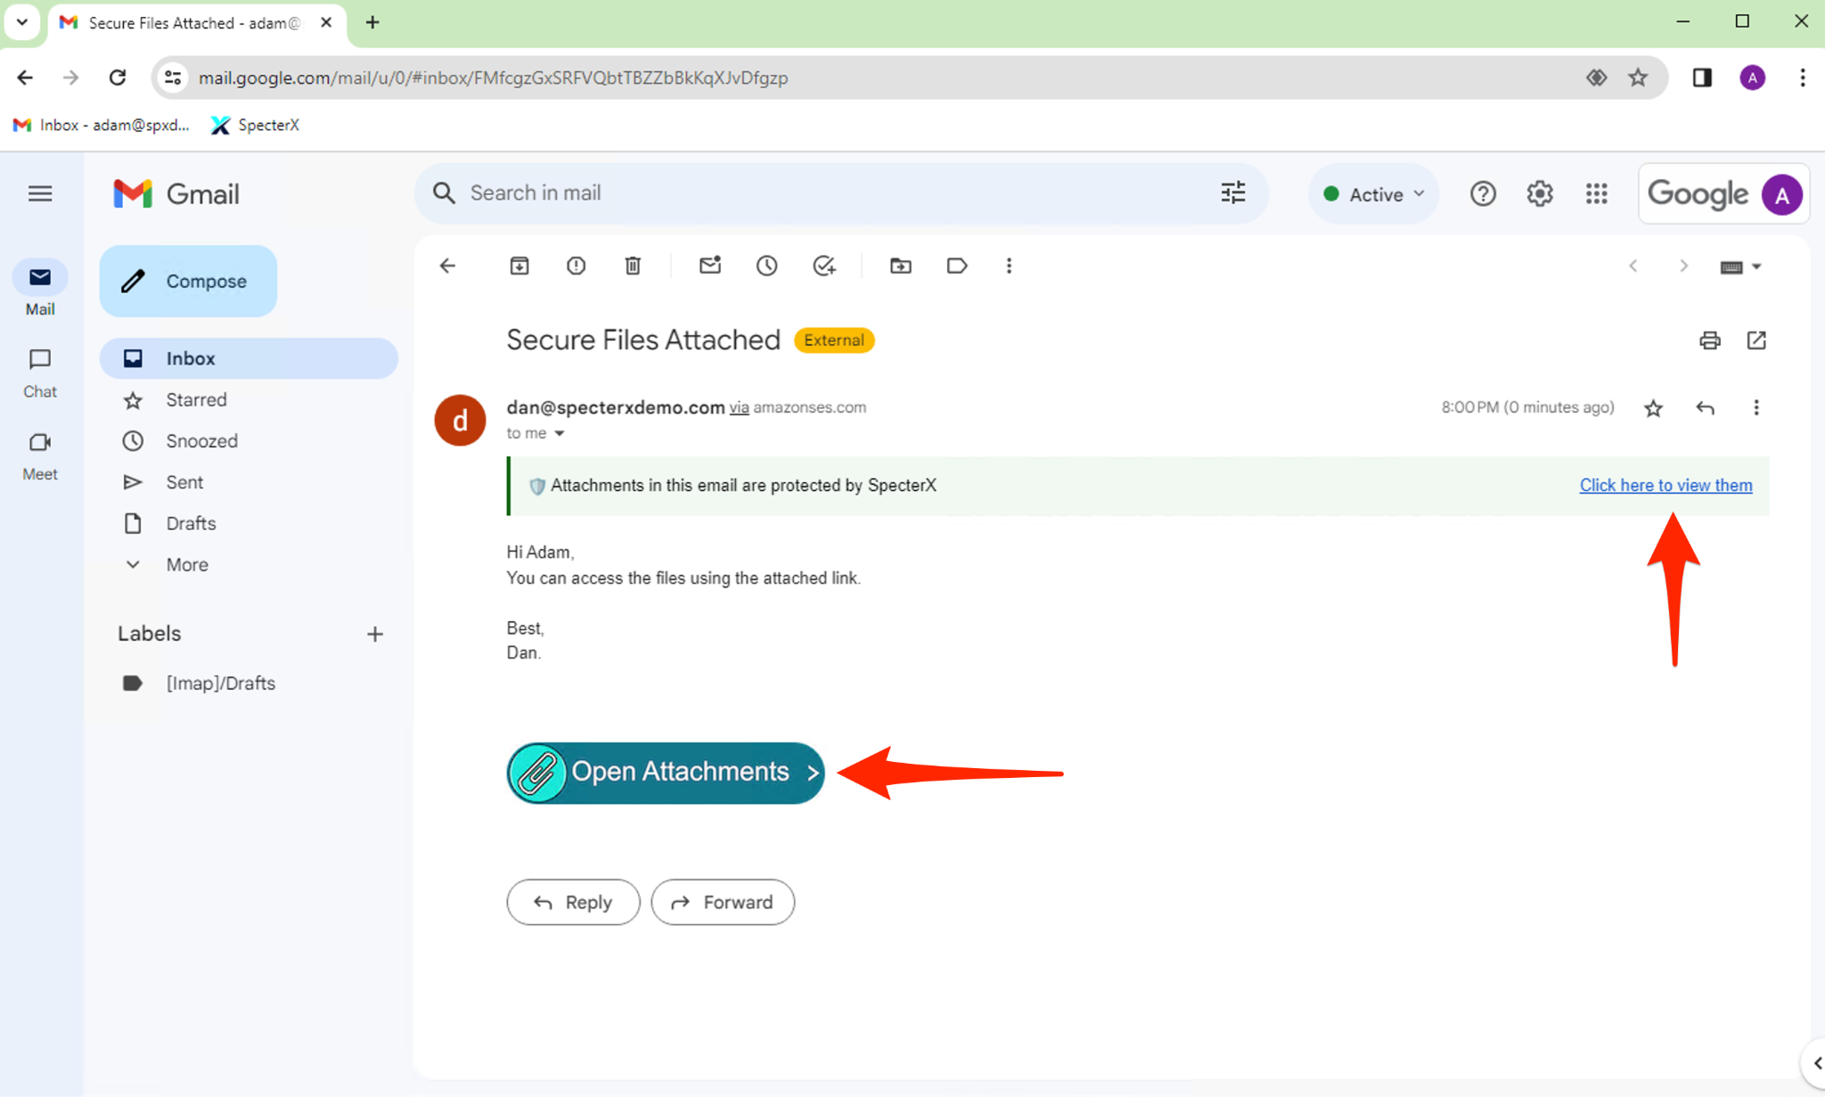
Recipient Experience
Attached files are replaced by SpecterX access link while files are secured within the customer’s secure storage.

Slide 8
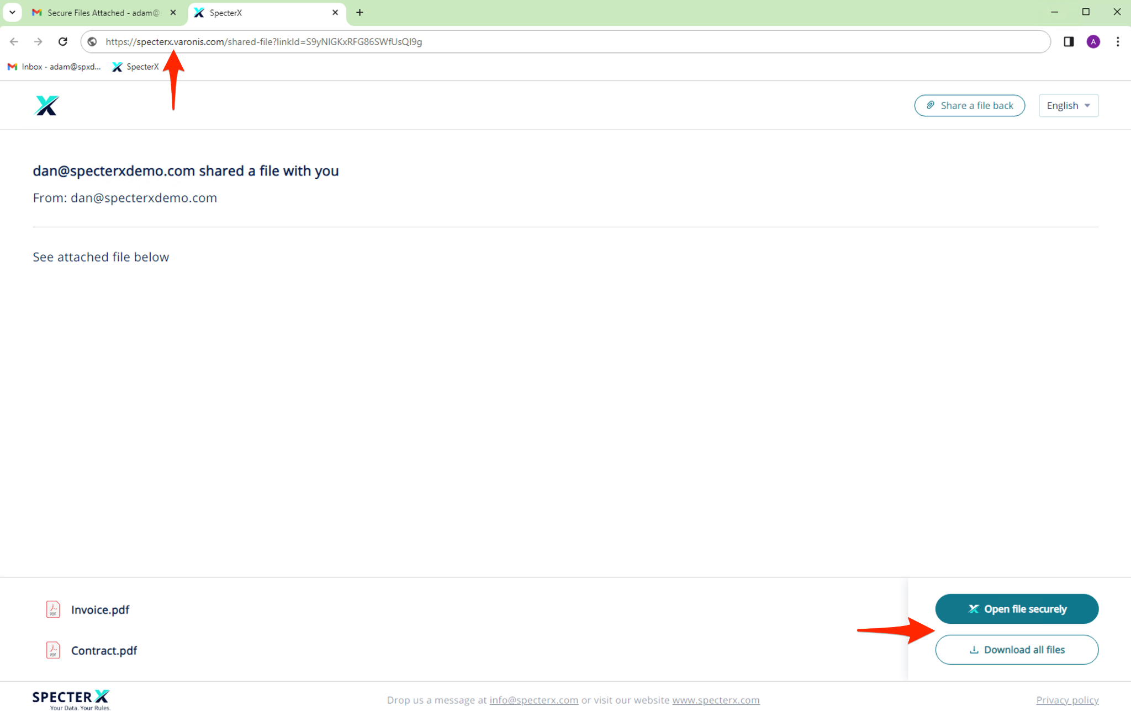


Recipient Experience
SpecterX recipient page hosted under the customer’s domain
Recipient can access (open/download) the files securely

Slide 9
Further Conversation Topics
MPS Architecture
Components
Add-in
Prerequisites
DLP and Mail flow
Transport rules
MX Record
FW
Implementation Process

Slide 10

Questions?

